Slide 1
CHAPTER 9 survey research

Slide 2
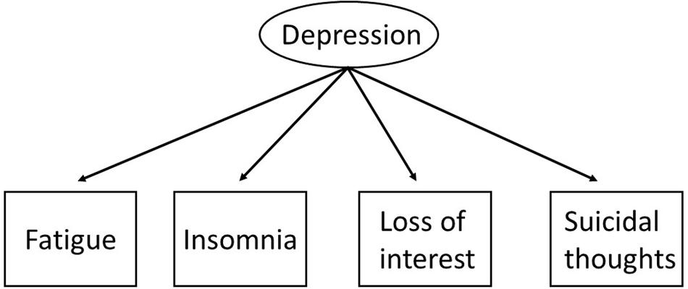
Why use survey research?
Descriptive, exploratory, and explanatory
Measure latent variables

Slide 3
Why use survey research?
Units of analysis = respondents
  Respondents – A person who provides data for analysis by responding to a survey questionnaire.
Easy to get large samples
Commonly measure attitudes and orientations

Slide 4
Guidelines for Asking Questions
Questionnaire – A document containing questions and other types of items designed to solicit information appropriate for analysis.
Interview – Participant verbally answers questions

Slide 5
Guidelines for Asking Questions
Choose Appropriate Question Forms
  Statements vs. Questions
    Example: I sometimes feel blue.
    Example: When was the last time you felt blue?
How will you measure responses?
  Scales vs. indexes

Slide 6
Guidelines for Asking Questions
Open-Ended and Closed-Ended Questions
  Open-Ended Questions – Questions for which the respondent is asked to provide their own answers.
  Closed-Ended Questions –Respondent is asked to select an answer from among a list provided by the researcher.

Slide 7
Guidelines for Asking Questions
Make Items Clear
Avoid Double-Barreled Questions
  Items should only measure one thing!
    “Cars should be faster and safer.”
Items Should Be Relevant
Short Items are Best
Avoid Biased Items and Terms

Slide 8
Guidelines for Asking Questions
Who are your respondents?
  Respondents Must Be Competent to Answer
  Respondents Must Be Willing to Answer

Slide 9
Questionnaire Construction
General Questionnaire Format
  Uncluttered
  One question per line
  Consistent format

Slide 10
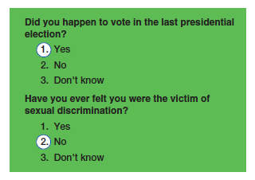

Slide 11
Questionnaire Construction
Contingency Question – A survey question intended for only some respondents, determined by their responses to some other question.

Slide 12
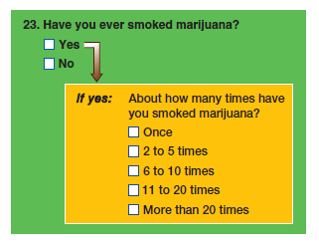

Slide 13
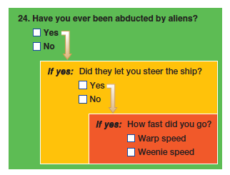

Slide 14
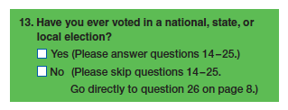

Slide 15
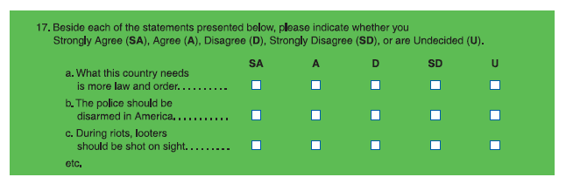

Slide 16
Questionnaire Construction
Ordering Items in a Questionnaire
  Appearance
  Open-Ended or Closed-Ended First?
  Randomized Ordering
  Demographic questions should go at the end
Questionnaire Instructions
  Introductory comments and clear instructions
Pre-testing the Questionnaire

Slide 17
Self-Administered Questionnaires
Questionnaires in which respondents are asked to complete the questionnaire by themselves.
Mail Distribution and Return
  Why do people not return questionnaires?
Online (weblink)

Slide 18
Self-Administered Questionnaires
Response Rate – The number of people participating in a survey divided by the number selected in the sample.
  Ideal = higher than 70%
  Why is a low response rate bad?
  What can be done to improve response?

Slide 19
Interview Surveys
Interview – A data-collection encounter in which one person (interviewer) asks questions of another (respondent).
Interviewers solicit higher response rates (80-85%) than mail surveys.
  Why?

Slide 20
Interview Surveys
Interviews minimized “don’t know” and “no answer.”
Interviewers serve as a guard against confusion.
Interviewers can observe respondents while completing the questionnaire.

Slide 21
Interview Surveys
Coordination and Control
  Training
    General guidelines (have a script!)
    How to handle difficult situations
    Practice interviews
    “Real” interviews

Slide 22
Telephone Surveys
Advantages
  95.5% of households have at least one phone (landline, cell, etc)
  Time and money
  Control
  Personal safety

Slide 23
Telephone Surveys
Disadvantages
  Unlisted phone numbers
  Cell phones
  Answering machines/voicemail/caller ID

Slide 24
Phone Surveys
Are phone surveys representative?

Slide 25
Online Surveys
Online Surveys
  Available software and websites
  Finding respondents?

Slide 26
Online Surveys
DO use consistent wording.
DO use simple language.
DON’T force excessive scrolling.
DO offer to share select result with respondents.

Slide 27
Online Surveys
DO plan time and day of initial emailing.
DO be aware of technical limitations.
DO test incentives, rewards, and prizes.
DO limit studies to less than 15 minutes.

Slide 28
Online Surveys
Are online surveys representative?

Slide 29
Mixed Mode Surveys
Combine different research techniques
  Example 1: A survey combined with a review of existing data and in-depth field observations and interviews.
  Example 2: Participants complete a survey questionnaire as part of a larger experiment

Slide 30
Strengths of Survey Research
Strengths
  Useful in describing large populations
  Make large samples possible
  Surveys are flexible
  Standardized questions

Slide 31
Weaknesses of Survey Research
Weaknesses
  “Round pegs in square holes”
  Seldom deal with context of social life
  Inflexible
  Weak on validity (but strong on reliability)

Slide 32
Weaknesses of Survey Research
Other big weakness….
Response Bias!!!!

Slide 33
Ethics and Survey Research
Surveys often ask for private information, which must be kept confidential.
Because asking questions can cause psychological discomfort or harm to respondents, researchers should minimize this risk.

Slide 34
Finding Psychological Questionnaires
Google Scholar
International Personality Item Pool (IPIP)

